Slide 1

HR Analytics:
EMPLOYEE RETENTION

Slide 2


MENTOR – BIDHAN SEN
TEAM
ANUSHKA PRATAP
PRESENTED BY: ANUSHKA PRATAP

Slide 3
TEAM
PRESENTED BY: ANUSHKA PRATAP

Slide 4
Introduction & Problem Statement
Business Objective
KPIs
Dashboard
Conclusion
AGENDA :
PRESENTED BY: ANUSHKA PRATAP

Slide 5
INTRODUCTION:
PROBLEM STATEMENT:
HR analytics involves the collection and analysis of HR-related data, including employee data, performance metrics, and other relevant data points. By using advanced analytical tools and techniques, HR analytics provides valuable insights into HR processes and trends, enabling organizations to make more informed decisions about their employees and improve overall performance.
Average attrition rate for all Departments
Average hourly rate of Male Research Scientist
Attrition rate Vs Monthly Income stats
Attrition by Marital Status
Department-wise Job Satisfaction
Count of Employees based on Educational Field
Department-wise count of Employees
Average working years for each Department
Percentage of Employees based on gender.
Attrition rate Vs Years Since last promotion
PRESENTED BY: ANUSHKA PRATAP

Slide 6
Business Objective:
The aim of this project is to analyze employee retention and attrition rates with the organization and provide insights to the HR team for developing effective retention strategies. Through data analysis and visualizations, we will identify factors that contribute to :
Employee turnover and attrition.
Evaluate the effectiveness of existing retention strategies.
To verify the satisfaction level of employee in the organization.
Provide recommendations to improve employee retention.
PRESENTED BY: ANUSHKA PRATAP

Slide 7
KPI 1 Average Attrition rate for all Departments
This KPI is to find out the
relationship between each
department and its attrition rate and here attrition rate is highest for Research & Development Department whereas lowest is for Hardware Department.
PRESENTED BY: ANUSHKA PRATAP

Slide 8
Insights from KPI 1:
We can clearly say that attrition rate of employees for every department is almost 50% which indicates that attrition rate of employees does not depends on department. So, irrespective of the department almost 50% of employees are leaving the company.
From this calculation and visualization we concluded that we must make strong strategies to minimize attrition rate and improve our company’s Employee retention so that we can balance the company’s growth and right talent.
PRESENTED BY: ANUSHKA PRATAP

Slide 9
KPI 2 Average Hourly rate of Male Research Scientist
PRESENTED BY: ANUSHKA PRATAP

Slide 10
KPI 3 Attrition Rate Vs Monthly Income Stats
This KPI is to find out the relation the between monthly income and Attrition rate.
PRESENTED BY: ANUSHKA PRATAP

Slide 11
Insights from KPI 3:
Based on our analysis and visualization, it is evident that the Hardware Department has the lowest attrition rate of 49.80%, with an average monthly income of Rs. 26,091.20. On the other hand, the Research and Development Department has the highest attrition rate of 51.26%, with an average monthly income of Rs. 26,007.08
PRESENTED BY: ANUSHKA PRATAP

Slide 12
KPI 4 Attrition By Marital Status
PRESENTED BY: ANUSHKA PRATAP

Slide 13
KPI 5 Department-wise Job Satisfaction
PRESENTED BY: ANUSHKA PRATAP

Slide 14
KPI 6 Count of Employees based on Educational Field
PRESENTED BY: ANUSHKA PRATAP

Slide 15
KPI 7 Department-wise Count of Employees
PRESENTED BY: ANUSHKA PRATAP

Slide 16
KPI 8 Avg Working hours Department- wise
Insights from KPI 4:
From this we can see the average working years in software department is high as compared to the rest of the departments and lowest is for Research & Development Department.
From the analysis we can conclude that average working years is approximately 20 for all the departments.
PRESENTED BY: ANUSHKA PRATAP

Slide 17
KPI 9 Percentage of Employees based on Gender
PRESENTED BY: ANUSHKA PRATAP

Slide 18
KPI 10 Attrition rate vs Years since Last Promotion
PRESENTED BY: ANUSHKA PRATAP

Slide 19
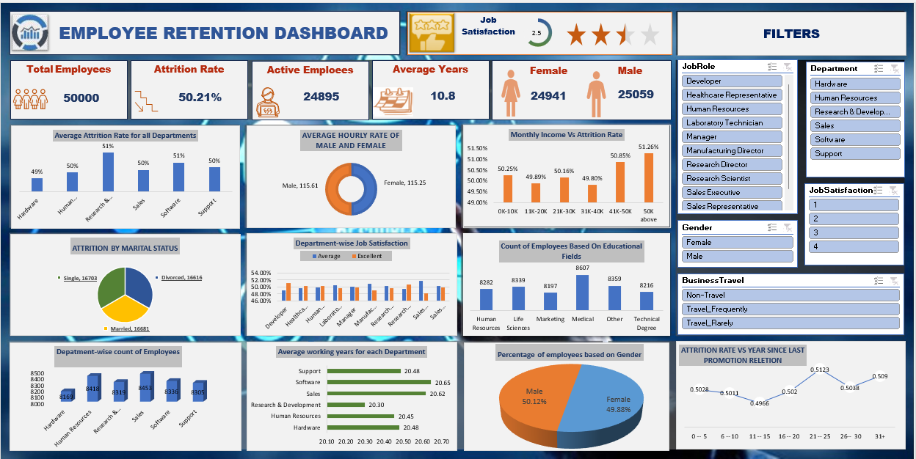

Slide 20
Conclusion :
Conduct stay interviews: Instead of exit interviews, conduct stay interviews with employees to gather feedback about the job.
Improve employee engagement: Implement initiatives to improve employee engagement, such as regular feedback, recognition and rewards programs, and opportunities for career growth.
Address workload issues: Ensure employees have manageable workloads by regularly monitoring and adjusting workloads to prevent burnout and overwhelm.
Create a positive work environment: Foster a positive work environment by promoting a culture of respect, inclusivity, and teamwork. Encourage open communication and collaboration among employees.
Address pay and compensation issues: Ensure that employees receive fair pay and compensation for their work and to find out what motivates an employee to continue to work in an organization.
PRESENTED BY: ANUSHKA PRATAP

Slide 21
THANK YOU

